Slide 1

Basic Algorithms
Recursion, Greedy, Sorting and Searching
SoftUni Team
Technical Trainers
Software University
http://softuni.bg

Slide 2
Table of Contents
Recursion
Brute-Force Algorithms
Greedy Algorithms
Greedy Failure Cases
Simple Sorting Algorithms
Searching Algorithms

Slide 3
Have a Question?
sli.do
#csharp-advanced

Slide 4

Recursion
What is Recursion?

Slide 5

What is Recursion?
A function or a method that calls itself one or more times until a specified condition is met
When it is, the rest of each repetition is processed from the last one called to the first

Slide 6
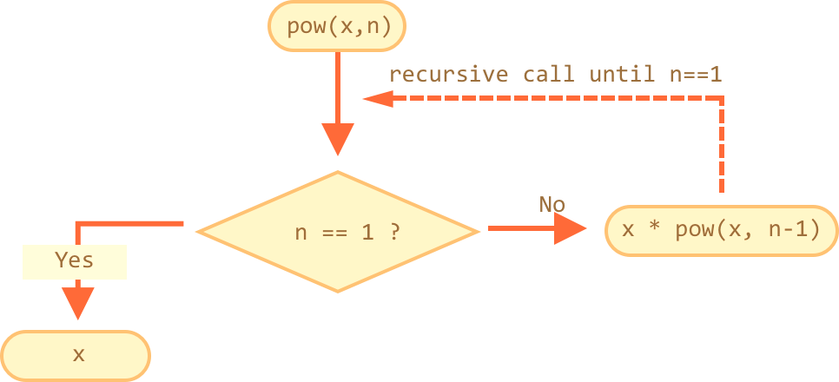
How Does It Work?
The function or method has a base case
Each step of the recursion should move towards the base case

Slide 7
Example: Array Sum
Sum(n - 1)
1
2 | 3 | 4
Sum(n)
Sum((n – 1) - 1)
1 | 2 | 3 | 4
1
2
3 | 4
Sum(((n – 1) - 1) – 1)
1
2
3
4
Base case

Slide 8
Example: Recursive Factorial
Recursive definition of n! (n factorial):
Pseudocode
N!
5
120
10
3628800
n! = n * (n–1)! for n > 0
0! = 1

Slide 9
Recursion Pre-Actions and Post-Actions
Recursive methods have 3 parts:
Pre-actions (before calling the recursion)
Recursive calls (step-in)
Post-actions (after returning from recursion)
static void Recursion
{ // Pre-actions
Recursion();
// Post-actions }

Slide 10
Direct and Indirect Recursion
Direct recursion
A method directly calls itself
Indirect recursion
Method A calls B, method B calls A
Or even A → B → C → A
void A()
{
…
A();
}
void A() {
…
B();
}
void B() {
…
A();
}

Slide 11
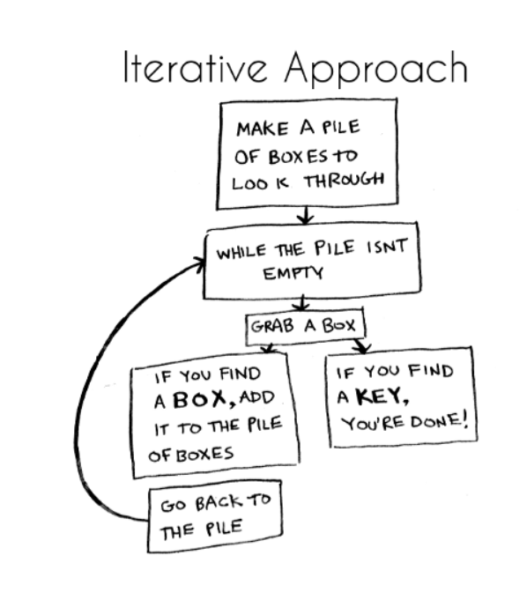
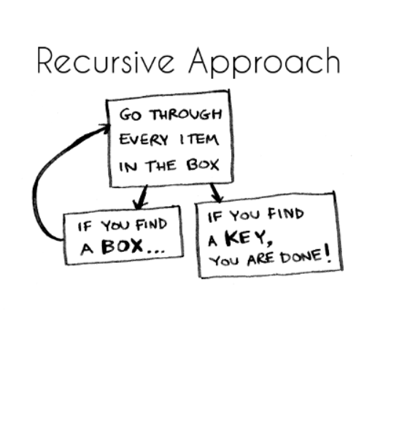
Iterative vs. Recursive Approach
A function repeats a defined process until a condition fails
A function that calls itself repeatedly until a certain condition is met

Slide 12

Recursion
Live Demo

Slide 13
Problem: Recursive Array Sum
Write a recursive method that:
Finds the sum of all numbers stored in an int[] array
Read numbers from the console
1 2 3 4
10
-1 0 1
0

Slide 14
Solution: Recursive Array Sum
static int Sum(int[] array, int index)
{
if (index == array.Length - 1)
{
return array[index];
}
return array[index] + Sum(array, index + 1);
}

Slide 15

Problem: Recursive Factorial
Create a recursive method that calculates n!
Read n from the console
5
120
10
3628800

Slide 16
Solution: Recursive Factorial
static long Factorial(int num)
{
if (num == 0)
{
return 1;
}
return num * Factorial(num - 1)
}
Base case

Slide 17

Brute-Force Algorithms

Slide 18
Brute-Force Algorithms
Trying all possible combinations
Picking the best solution
Usually slow and inefficient
0
0
0
0
0

Slide 19
Brute-Force Algorithms
0
0
0
0
0

Slide 20
Brute-Force Algorithms
0
0
0
0
1

Slide 21
Brute-Force Algorithms
0
0
0
0
2

Slide 22
Brute-Force Algorithms
9
9
9
9
9
10 x 10 x 10 x 10 x 10 = 100,000 combinations

Slide 23

Greedy Algorithms

Slide 24
Greedy Algorithms
Used for solving optimization problems
Usually more efficient than the other algorithms
Can produce a non-optimal (incorrect) result
Pick the best local solution
The optimum for a current position and point of view
Greedy algorithms assume that always choosing a local optimum leads to the global optimum

Slide 25
Optimization Problems
Finding the best solution from all possible solutions
Examples:
Find the shortest path from Sofia to Varna
Find the maximum increasing subsequence
Find the shortest route that visits each city and returns to the origin city

Slide 26
Greedy Algorithms
Live Demo

Slide 27
Problem: Sum of Coins
Write a program, which gathers a sum of money, using the least possible number of coins
Consider the US currency coins
0.01, 0.02, 0.05, 0.10
Greedy algorithm for "Sum of Coins":
Take the largest coin while possible
Then take the second largest
Etc.
1$
1¢
50¢
5¢
25¢
4¢

Slide 28
Sum of Coins Visualization
Target: 18
10¢
5¢
2¢
1¢
10¢
5¢
2¢
1¢
Actual:
0

Slide 29
Sum of Coins Visualization
Target: 18
10¢
5¢
2¢
1¢
5¢
2¢
1¢
Actual:
10
10¢

Slide 30
Sum of Coins Visualization
Target: 18
10¢
5¢
2¢
1¢
2¢
1¢
Actual:
15
10¢
5¢

Slide 31
Sum of Coins Visualization
Target: 18
10¢
5¢
2¢
1¢
1¢
Actual:
17
10¢
5¢
2¢

Slide 32

Sum of Coins Visualization
Target: 18
10¢
5¢
2¢
1¢
Actual:
18
10¢
5¢
2¢
1¢

Slide 33
Solution: Sum of Coins
int finalSum = 18;
int currentSum = 0;
int[] coins = { 10, 10, 5, 5, 2, 2, 1, 1 };
Queue<int> resultCoins = new Queue<int>();
// Next Slide
Console.WriteLine("Sum not found");

Slide 34
Solution: Sum of Coins (2)
for (int i = 0; i < coins.Length; i++)
{
if (currentSum + coins[i] > finalSum) continue;
currentSum += coins[i];
resultCoins.Enqueue(coins[i]);
if (currentSum == finalSum)
// Sum Found
}

Slide 35
Problem: Set Cover
Write a program that finds the smallest subset of S, the union of which = U (if it exists)
You will be given a set of integers U called "the Universe"
And a set S of n integer sets whose union = U
Universe: 1, 2, 3, 4, 5
Number of sets: 4
1
2, 4
5
3
Sets to take (4):
{ 2, 4 }
{ 1 }
{ 5 }
{ 3 }

Slide 36
Solution: Set Cover
public static List<int[]> ChooseSets(List<int[]> sets, List<int> universe)
{
List<int[]> selectedSets = new List<int[]>();
while (universe.Count > 0)
{
// Next Slide
}
return selectedSets;
}

Slide 37
Solution: Set Cover (2)
int[] current = sets.OrderByDescending(set => set.Count(universe.Contains)).First();
selectedSets.Add(current);
sets.Remove(current);
foreach (int i in current)
{
universe.Remove(i);
}

Slide 38


Greedy Failure Cases

Slide 39
Sum of Coins Failure
Target: 18
10¢
5¢
4¢
1¢
10¢
5¢
4¢
1¢
10¢
5¢
4¢
1¢
Actual:
0

Slide 40
Sum of Coins Failure
Target: 18
10¢
5¢
4¢
1¢
10¢
5¢
4¢
1¢
5¢
4¢
1¢
Actual:
10
10¢

Slide 41
Sum of Coins Failure
Target: 18
10¢
5¢
4¢
1¢
10¢
5¢
4¢
1¢
4¢
1¢
Actual:
15
10¢
5¢

Slide 42
Sum of Coins Failure
Target: 18
10¢
5¢
4¢
1¢
10¢
5¢
4¢
1¢
4¢
Actual:
16
10¢
5¢
1¢

Slide 43
Sum of Coins Failure
Target: 18
10¢
5¢
4¢
1¢
10¢
5¢
4¢
4¢
Actual:
17
10¢
5¢
1¢
1¢

Slide 44
Sum of Coins Failure
Target: 18
10¢
5¢
4¢
10¢
5¢
4¢
4¢
Actual:
18
10¢
5¢
1¢
1¢
1¢

Slide 45

Sum of Coins Failure
Target: 18
10¢
5¢
1¢
1¢
1¢
10¢
4¢
4¢

Slide 46

Simple Sorting Algorithms

Slide 47
What is a Sorting Algorithm?
An algorithm that rearranges elements in a list in non-decreasing order
The elements must be comparable
More formally
The input is a sequence / list of elements
The output is an rearrangement / permutation of elements in non-decreasing order

Slide 48

Example: Sorting
Efficient sorting algorithms are important for:
Producing human-readable output
Canonicalizing data – making data uniquely arranged
In conjunction with other algorithms, like binary searching
Example of sorting:
Unsorted list
sorting
Sorted list
10 | 3 | 7 | 3 | 4
3 | 3 | 4 | 7 | 10

Slide 49
Classification
Sorting algorithms are often classified by
Computational complexity and memory usage
Worst, average and best case behavior
Recursive / non-recursive
Stability – stable / unstable
Comparison-based sort / non-comparison based
Sorting method: insertion, exchange (bubble sort and quicksort), selection (heapsort), merging, serial / parallel, etc.

Slide 50
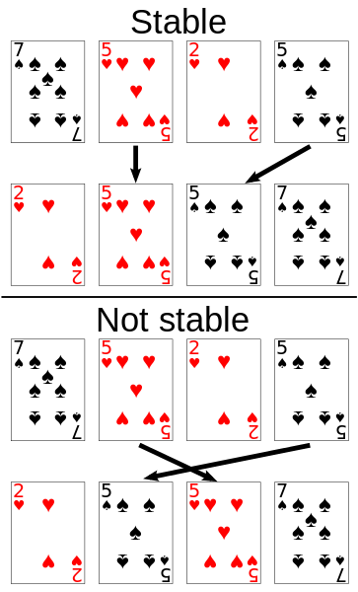
Stability of Sorting
Stable sorting algorithms
Maintain the order of equal elements
If two items compare as equal, their relative order is preserved
Unstable sorting algorithms
Rearrange the equal elements in unpredictable order
Often different elements have the same key used for equality comparing

Slide 51
Selection Sort
Selection sort – simple, but inefficient algorithm (visualize)
Swap the first with the min element on the right, then the second, etc.
Memory: O(1)
Stable: No
Method: Selection

Slide 52
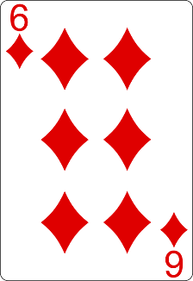
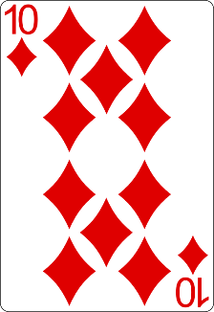
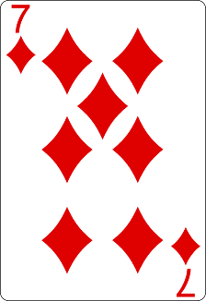
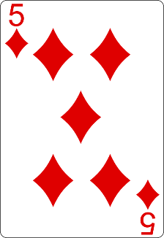
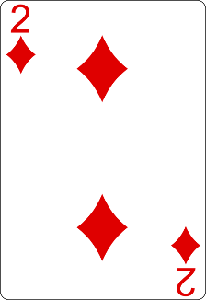
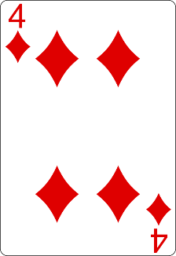
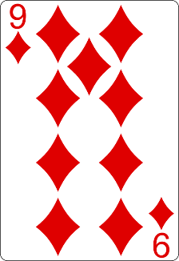
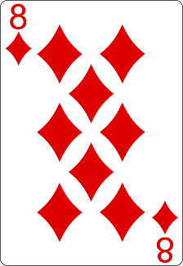
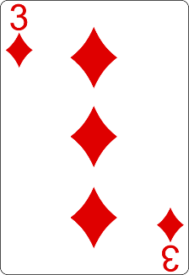
Selection Sort Visualization
Index
Min

Slide 53
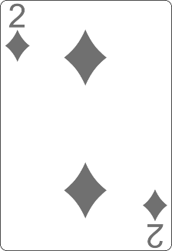
Selection Sort Visualization
Index
Min

Slide 54
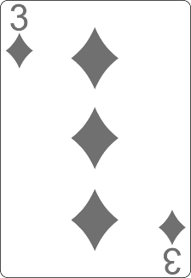
Selection Sort Visualization
Index
Min

Slide 55
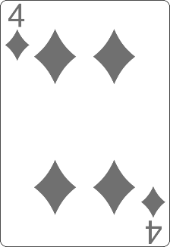
Selection Sort Visualization
Min
Index

Slide 56
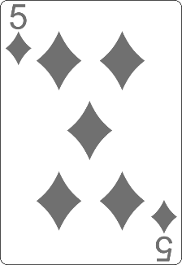
Selection Sort Visualization
Min
Index

Slide 57
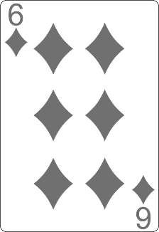
Selection Sort Visualization
Min
Index

Slide 58
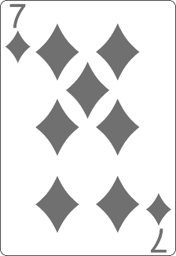
Selection Sort Visualization
Index
Min

Slide 59
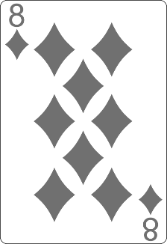
Selection Sort Visualization
Min
Index

Slide 60
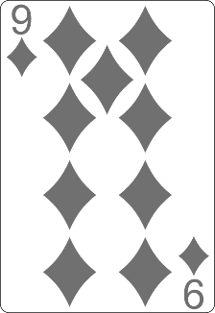
Selection Sort Visualization
Min
Index

Slide 61
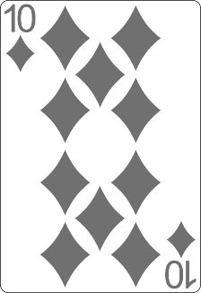
Selection Sort Visualization

Slide 62
Selection Sort Visualization

Slide 63
Selection Sort: Why Unstable?
Why the "selection sort" is unstable?
Swaps the first element with the min element on the right
Swaps the second element with the min element on the right
Etc.
During the swaps equal elements can jump over each other
left
min
swap
equal elements
changed order
3♥ | 5♠ | 3♦ | 4♥ | 2♣
3♥ | 5♠ | 3♦ | 4♥ | 2♣
2♣ | 5♠ | 3♦ | 4♥ | 3♥

Slide 64
Selection Sort Code
for (int index = 0; index < collection.Length; index++)
{
int min = index;
for (int curr = index + 1; curr < collection.Length; curr++)
{
if (Less(collection[curr], collection[min]))
{
min = curr;
}
}
Swap(collection, index, min);
}

Slide 65
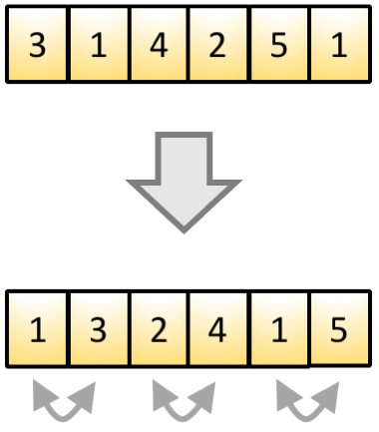
Bubble Sort
Bubble sort – simple, but inefficient algorithm (visualize)
Swaps to neighbor elements when not in order until sorted
Memory: O(1)
Stable: Yes
Method: Exchanging

Slide 66
Bubble Sort Visualization
i
j

Slide 67
Bubble Sort Visualization
i
j

Slide 68
Bubble Sort Visualization
i
j

Slide 69
Bubble Sort Visualization
i
j

Slide 70
Bubble Sort Visualization
i
j

Slide 71
Bubble Sort Visualization
i
j

Slide 72
Bubble Sort Visualization
i
j

Slide 73
Bubble Sort Visualization
i
j

Slide 74
Bubble Sort Visualization
i
j

Slide 75
Bubble Sort Visualization
i
j

Slide 76
Bubble Sort Visualization
i
j

Slide 77
Bubble Sort Visualization
i
j

Slide 78
Bubble Sort Visualization
i
j

Slide 79
Bubble Sort Visualization
i
j

Slide 80
Bubble Sort Visualization
i
j

Slide 81
Bubble Sort Visualization
i
j

Slide 82
Bubble Sort Visualization
i
j

Slide 83
Bubble Sort Visualization
i
j

Slide 84
Bubble Sort Visualization
i
j

Slide 85
Bubble Sort Visualization
i
j

Slide 86
Bubble Sort Visualization
i
j

Slide 87
Bubble Sort Visualization
i
j

Slide 88
Bubble Sort Visualization
i
j

Slide 89
Bubble Sort Visualization
i
j

Slide 90
Bubble Sort Visualization
i
j

Slide 91
Bubble Sort Visualization
i
j

Slide 92
Bubble Sort Visualization
i
j

Slide 93
Bubble Sort Visualization
i
j

Slide 94
Bubble Sort Visualization
i
j

Slide 95
Bubble Sort Visualization
i
j

Slide 96
Bubble Sort Visualization
i
j

Slide 97
Bubble Sort Visualization
i
j

Slide 98
Bubble Sort Visualization
i
j

Slide 99
Bubble Sort Visualization
i
j

Slide 100
Bubble Sort Visualization
i
j

Slide 101
Bubble Sort Visualization

Slide 102
Example: Bubble Sort
int[] numbers = { 1, 3, 4, 2, 5, 6 };
for (int i = 0; i < numbers.Length; i++)
{
for (int j = i + 1; j < numbers.Length - 1; j++)
{
if (numbers[i] > numbers[j]) {
int tempNumber = numbers[i];
numbers[i] = numbers[j];
numbers[j] = tempNumber; }
}
}
Console.WriteLine(string.Join(" ", numbers));

Slide 103
Sorting Algorithms
Live Demo

Slide 104


Searching Algorithms

Slide 105
Search Algorithm
An algorithm for finding an item with specified properties among a collection of items
Typically answers either True or False to whether the item is present
Also may return where the item is found
The values might be integers, strings or even other kinds of objects

Slide 106
Linear Search
Linear search finds a particular value in a list (visualize)
Searches the whole sequence
Checks every element one at a time
Searches until the desired one is found
Worst and average performance: O(n)
for each item in the list:
if that item has the desired value,
return the item's location
return nothing

Slide 107
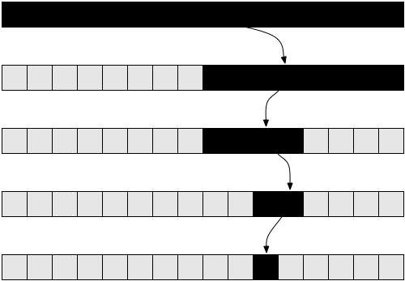
Binary Search
Binary search finds an item within a ordered data structure
At each step, compare the input with the middle element
The algorithm repeats its action to the left or right sub-structure
See the visualization
Complexity: O(log n)

Slide 108
Example: Binary Search (Iterative)
int BinarySearch(int arr[], int key, int start, int end)
{
while (end >= start) {
int mid = (start + end) / 2;
if (arr[mid] < key)
start = mid + 1;
else if (arr[mid] > key)
end = mid - 1;
else
return mid; }
return KEY_NOT_FOUND;
}

Slide 109

Summary
…
…
…
Recursion – a method or a function that calls itself
Brute-Force - trying all the possible solutions
Greedy - picking a locally optimal solution
Sorting
Bubble Sort
Searching
Linear and Binary

Slide 110
https://softuni.bg/trainings/courses

Slide 111












SoftUni Diamond Partners

Slide 112




SoftUni Organizational Partners

Slide 113




Trainings @ Software University (SoftUni)
Software University – High-Quality Education and Employment Opportunities
softuni.bg
Software University Foundation
http://softuni.foundation/
Software University @ Facebook
facebook.com/SoftwareUniversity
Software University Forums
forum.softuni.bg

Slide 114

License
This course (slides, examples, demos, videos, homework, etc.) is licensed under the "Creative Commons Attribution-NonCommercial-ShareAlike 4.0 International" license

